Slide 1
Chapter 2
E-commerce Fundamentals

Slide 2
Learning outcomes
Evaluate changes in business relationships between organizations and their customers enabled by e-commerce
Identify the main business and marketplace models for electronic communications and trading
Describe different revenue models and transaction mechanisms available through online services.

Slide 3
Management issues
What are the implications of changes in marketplace structures for how we trade with customers and other partners?
Which business models and revenue models should we consider in order to exploit the Internet?
What will be the importance of online intermediaries and marketplace hubs to our business and what actions should we take to partner these intermediaries?

Slide 4
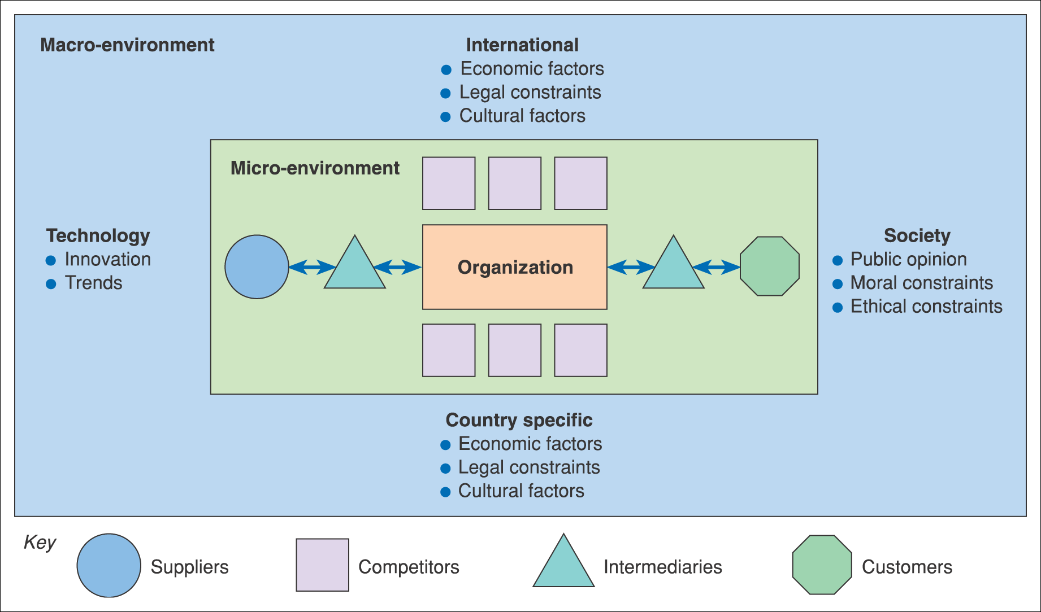
Figure 2.1 The environment in which e-business services are provided

Slide 5
Activity – the e-commerce environment
For each of the environment influences shown in Figure 2.1, give examples of why it is important to monitor and respond in an
e-business context. For example, the personalization mentioned in the text is part of why it is important to respond to technological innovation.

Slide 6
Environment constraints and opportunities
Customers – which services are they offering via their web site that your organization could support them in?
Competitors – need to be benchmarked in order to review the online services they are offering – do they have a competitive advantage?
Intermediaries – are new or existing intermediaries offering products or services from your competitors while you are not represented?
Suppliers – are suppliers offering different methods of procurement to competitors that give them a competitive advantage?
Macro-environment
Society – what is the ethical and moral consensus on holding personal information?
Country specific, international legal – what are the local and global legal constraints for example on holding personal information, or taxation rules on sale of goods?
Country specific, international economic – what are the economic constraints of operating within a country or global constraints?
Technology – what new technologies are emerging by which to deliver online services such as interactive digital TV and mobile phone-based access?

Slide 7
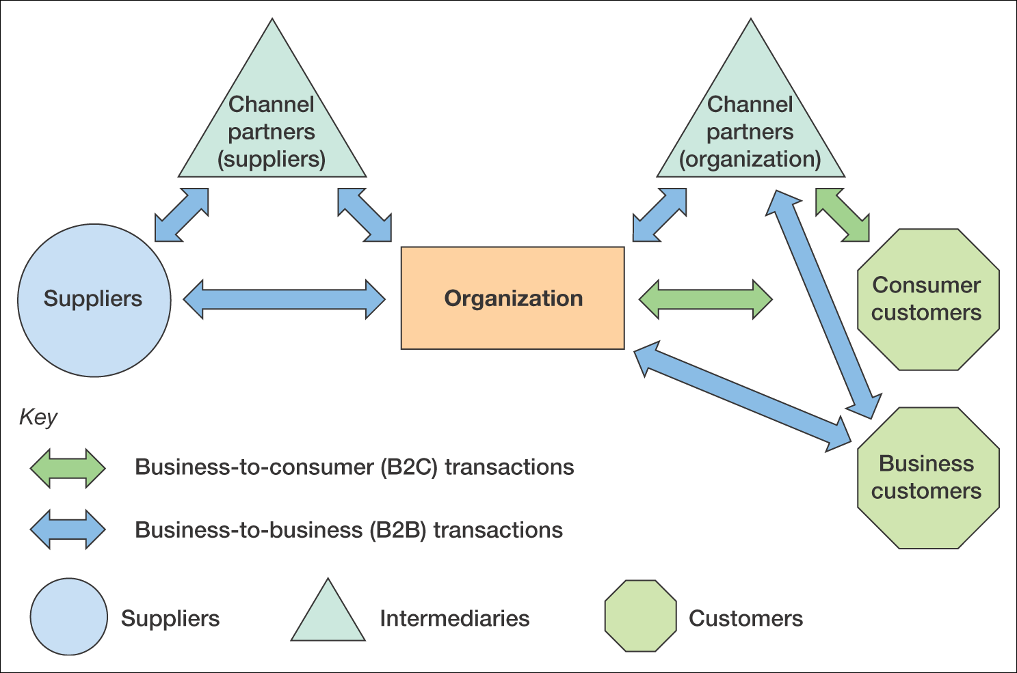
Figure 2.2 B2B and B2C interactions between an organization, its suppliers and its customers

Slide 8
B2B and B2C characteristics
Characteristic | B2C | B2B
Proportion of adopters with access | Low to medium | High to very high
Complexity of buying decisions | Relatively simple – individual and influencers | More complex – buying process involves users, specifiers, buyers, etc.
Channel | Relatively simple – direct or from retailer | More complex, direct or via wholesaler, agent or distributor
Purchasing characteristics | Low value, high volume or high value, low volume. May be high involvement | Similar volume/value. May be high Involvement. Repeat orders (rebuys) more common
Product characteristic | Often standardized items | Standardized items or bespoke for sale

Slide 9
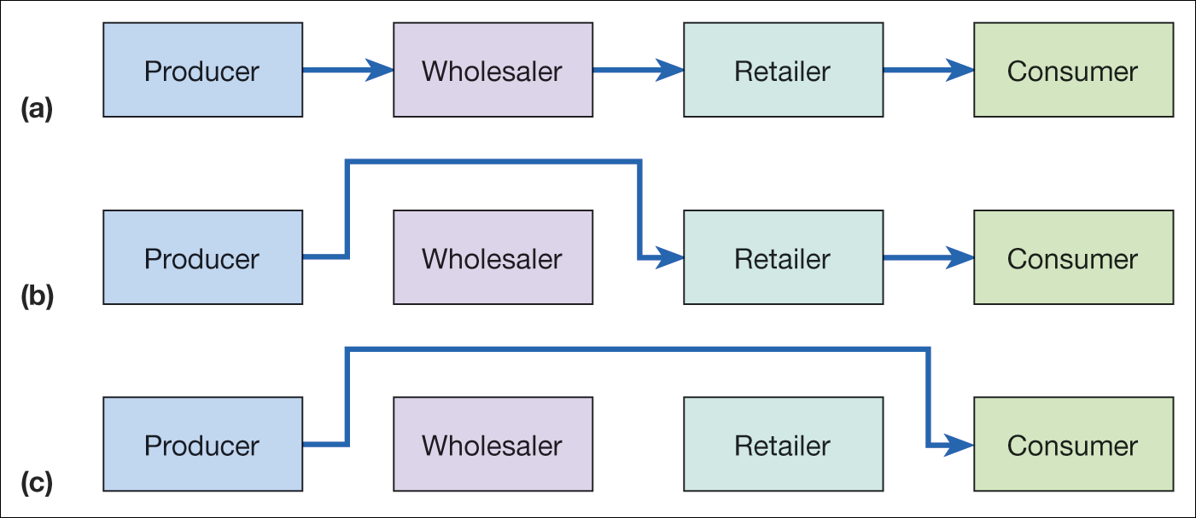
Figure 2.3 Disintermediation of a consumer distribution channel showing
(a) the original situation, (b) disintermediation omitting the wholesaler, and
(c) disintermediation omitting both wholesaler and retailer

Slide 10
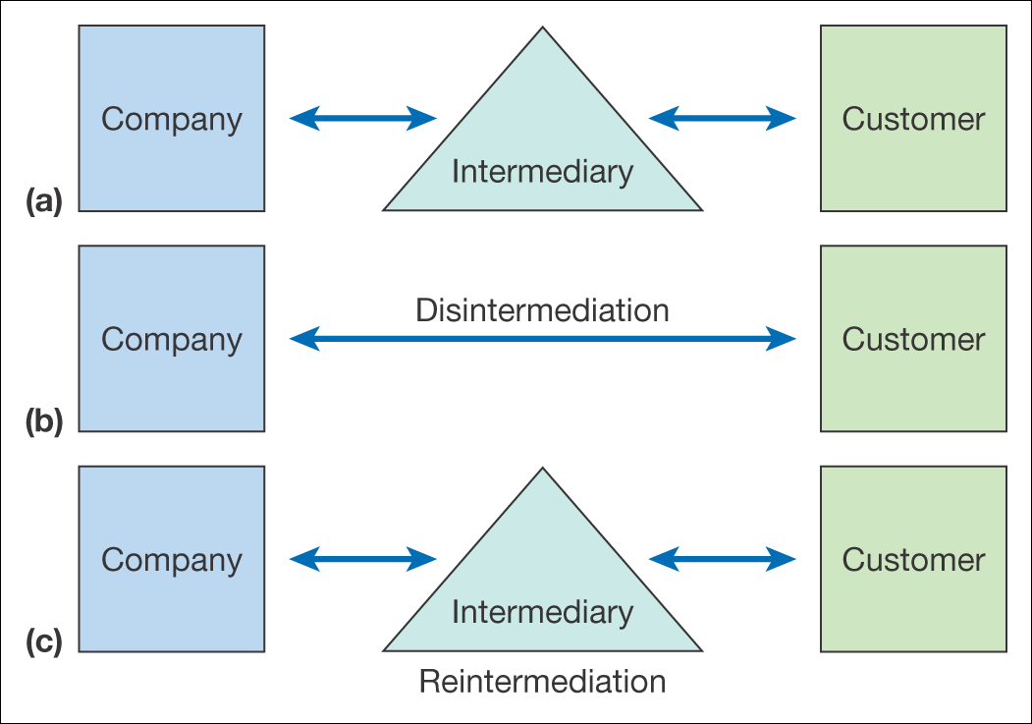
Figure 2.4 From original situation (a) to disintermediation (b) and reintermediation (c)

Slide 11
Countermediation
Creation of a new intermediary
Example:
  B&Q www.diy.com
  Opodo www.opodo.com
  Boots www.wellbeing.com www.handbag.com
  Ford, Daimler (www.covisint.com)
Partnering with existing intermediary – Mortgage broker Charcol and Freeserve

Slide 12
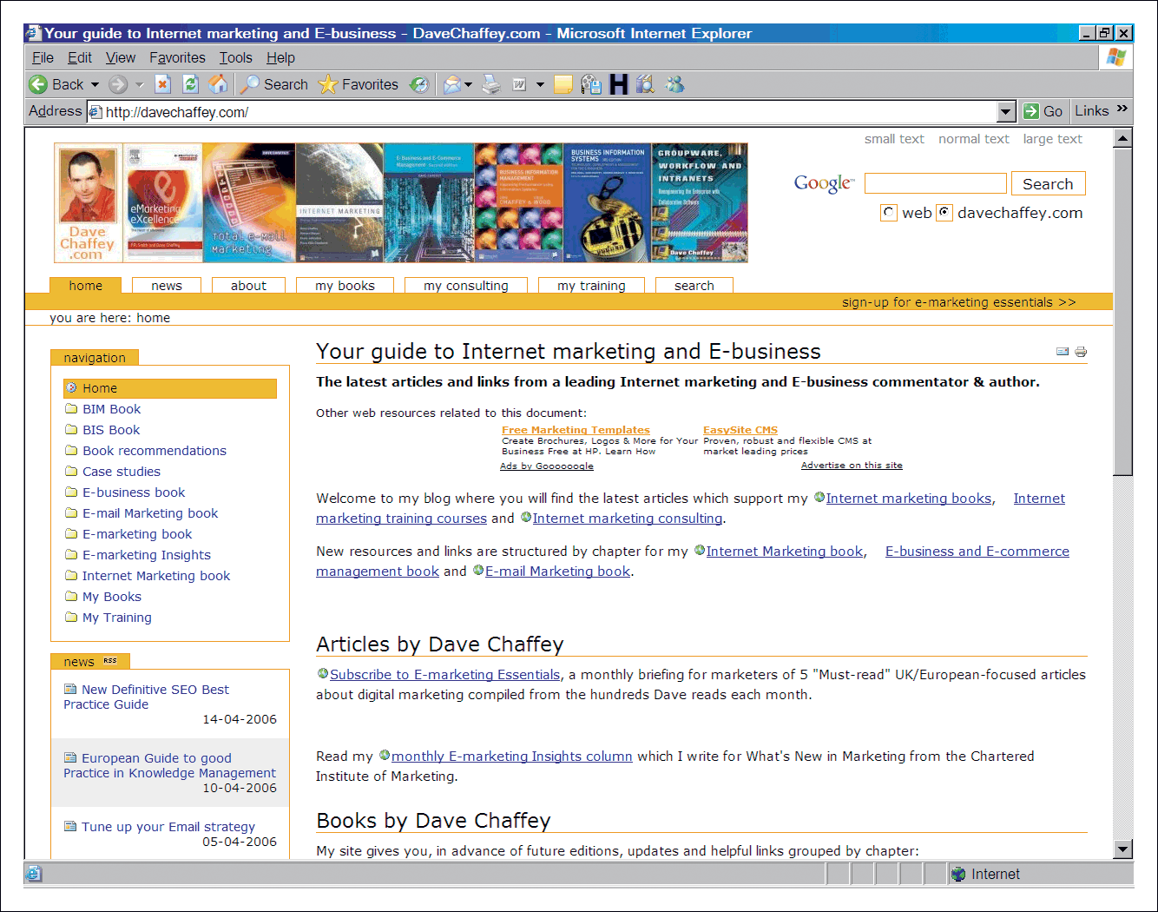
Figure 2.5 Dave Chaffey’s blog site (www.davechaffey.com)

Slide 13
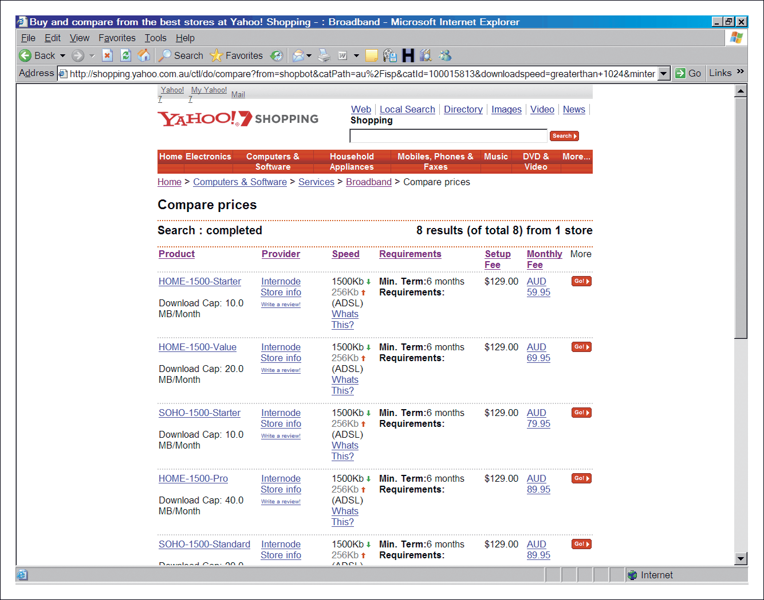
Figure 2.6 Yahoo! Shopping Australia, a price comparison site based on the
Kelkoo.com shopping comparison technology (http://shopping.yahoo.com.au)

Slide 14
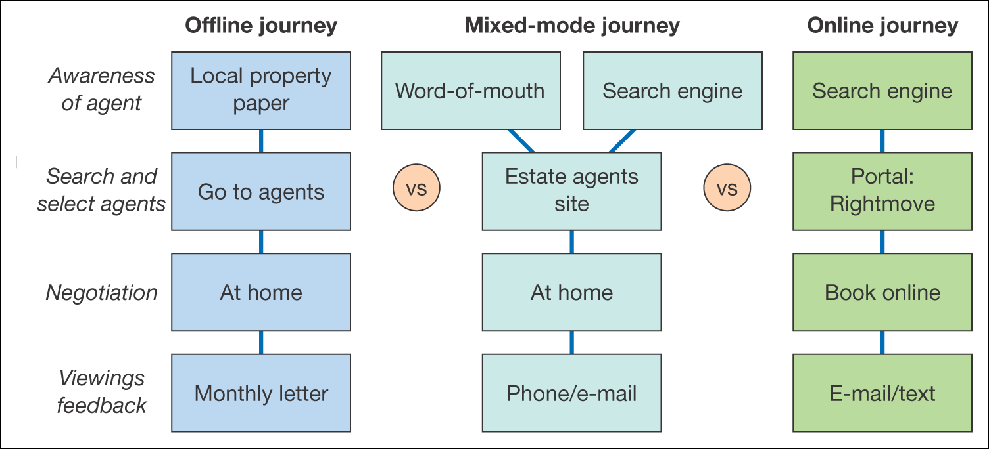
Figure 2.7 Example channel chain map for consumers selecting an estate agent
to sell their property

Slide 15
Portals
Q1. Define portal
Q2. Is a search engine the same as a portal? Yes, No
Q3. Is a search engine the same as a directory? Yes, No
Q4. List search engines / portals you use and explain why

Slide 16
Meta services
Search engines
Portal
‘A gateway to
information
resources and
services’
Directories
News aggregators
MR aggregators
Comparers
Exchanges

Slide 17
Types of portal
Type of portal | Characteristics | Example
Access portal | Associated with ISP | Wanadoo (www.wanadoo.com) and now (www.orange.co.uk) AOL (www.aol.com)
Horizontal or functional portal | Range of services: search engines, directories, news recruitment, personal information management, shopping, etc. | Yahoo! (www.yahoo.com) MSN (www.msn.com) Google (www.google.com) for which a long period just focused on search.
Vertical | A vertical portal covers a particular market such as construction with news and other services. | Construction Plus (www.constructionplus.co.uk) Chem Industry (www.chemindustry.com) Barbour Index for B2B resources (www.barbour-index.com) E-consultancy (www.e-consultancy.com) Focuses on e-business resources
Media portal | Main focus is on consumer or business news or entertainment. | BBC (www.bbc.co.uk) Guardian (www.guardian.co.uk) ITWeek (www.itweek.co.uk)
Geographical (Region, country, local) | May be: horizontal vertical | Google country versions Yahoo! country and city versions Craigslist (www.craigslist.com) Countyweb (www.countyweb.com)
Marketplace | May be: Horizontal Vertical Geographical | EC21 (www.ec21.com) eBay (www.eBay.com)
Search portal | Main focus is on Search | Google (www.google.com) Ask Jeeves (www.ask.com)
Media type | May be: Voice Video Delivered by streaming media or downloads of files | BBC (www.bbc.co.uk) Silicon (www.silicon.com)

Slide 18
Online representation
Place of purchase | Examples of sites
A. Seller-controlled | Vendor sites, i.e. home site of organization selling products, e.g. www.dell.com.
B. Seller-oriented | Intermediaries controlled by third parties to the seller such as distributors and agents, e.g. Opodo (www.opodo.com) represents the main air carriers
C. Neutral | Intermediaries not controlled by buyer’s industry, e.g. EC21 (www.ec21.com). Product-specific search engines, e.g. CNET (www.computer.com) Comparison sites, e.g. Barclay Square/Shopsmart (www.barclaysquare.com) Auction space, e.g. eBay (www.ebay.com)
D. Buyer-oriented | Intermediaries controlled by buyers, e.g. Covisint used to represent the major motor manufacturers (www.covisint.com) although they now don’t use a single marketplace, but each manufacturer uses technology to access its suppliers direct. Purchasing agents and aggregators
E. Buyer-controlled | Web site procurement posting on company’s own site, e.g. GE Trading Process Network (www.tpn.geis.com

Slide 19
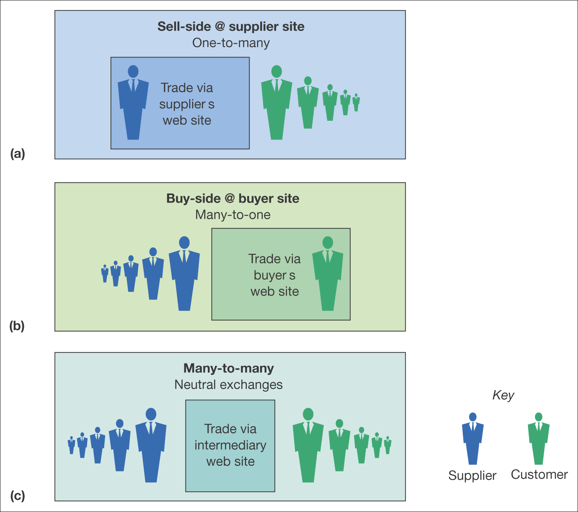
Figure 2.8 Variations in the location and scale of trading on e-commerce sites

Slide 20
Trading mechanisms
Commercial (trading) mechanism | Online transaction mechanism of Nunes et al. (2000)
1. Negotiated deal Example: can use similar mechanism to auction as on Commerce One (www.commerceone.net) | Negotiation – bargaining between single seller and buyer. Continuous replenishment – ongoing fulfilment of orders under pre-set terms
2. Brokered deal Example: intermediaries such as screentrade (www.screentrade.co.uk) | Achieved through online intermediaries offering auction and pure markets online
3. Auction Example: C2C: E-bay (www.ebay.com) B2B: Industry to Industry (http://business.ebay.co.uk/) | Seller auction – buyers’ bids determine final price of sellers’ offerings. Buyer auction – buyers request prices from multiple sellers. Reverse – buyers post desired price for seller acceptance
4. Fixed-price sale Example: all e-tailers | Static call – online catalogue with fixed prices. Dynamic call – online catalogue with continuously updated prices and features
5. Pure markets Example: electronic share dealing | Spot – buyers’ and sellers’ bids clear instantly
6. Barter Example: www.intagio.com and www.bartercard.co.uk | Barter – buyers and sellers exchange goods. According to the International Reciprocal Trade Association (www.irta.com ) barter trade was over $9 billion in 2002.

Slide 21
Business model
Timmers (1999) defines a ‘business model’ as:
An architecture for product, service and information flows, including a description of the various business actors and their roles; and a description of the potential benefits for the various business actors; and a description of the sources of revenue.

Slide 22
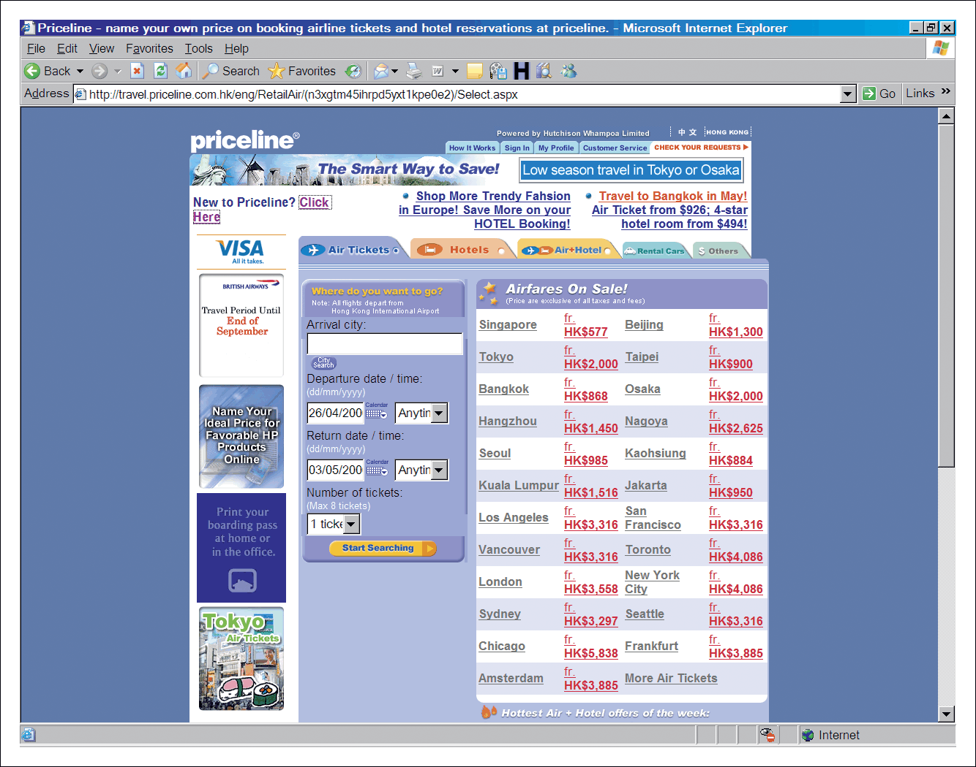
Figure 2.9 Priceline Hong Kong service (www.priceline.com.hk)

Slide 23
Revenue models – publisher example
1. Subscription access to content.
2. Pay-per-view access.
3. CPM on site display advertising.
4. CPC advertising on site.
5. Sponsorship of site sections, content or widgets.
6. Affiliate revenue (CPA or CPC).
7. Subscriber data access for e-mail marketing.
8. Access to customers for research purposes.

Slide 24
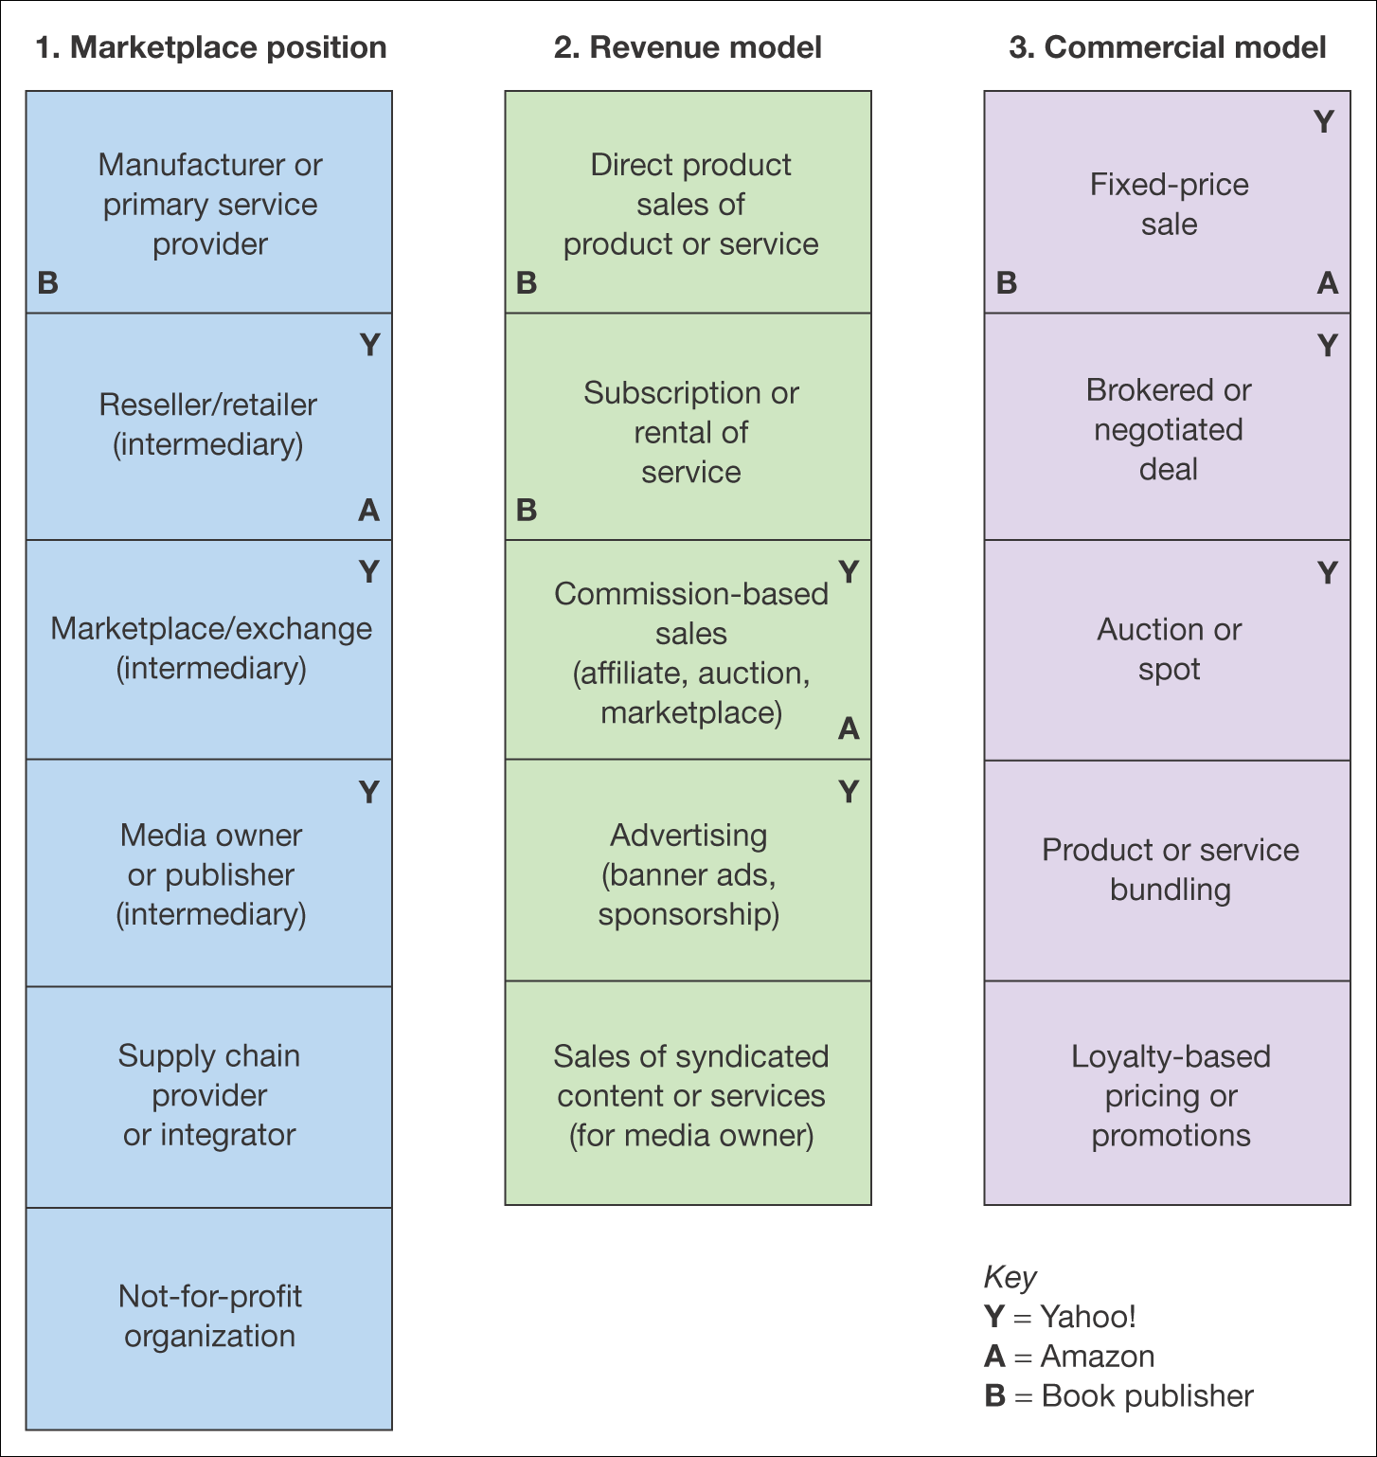
Figure 2.10 Alternative perspectives on business models

Slide 25
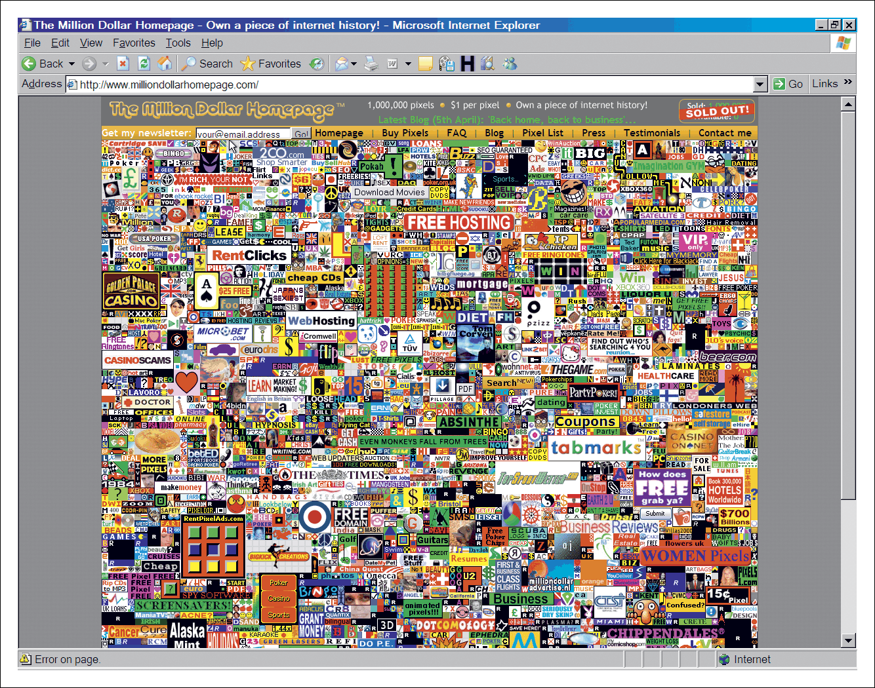
Figure 2.11 Alex Tew’s Million Dollar Home Page (www.milliondollarhomepage.com)

Slide 26
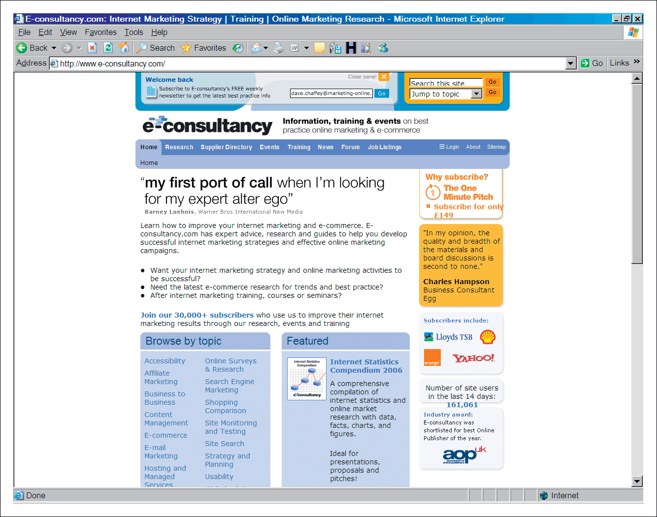
Figure 2.12 E-consultancy (www.e-consultancy.com)

Slide 27
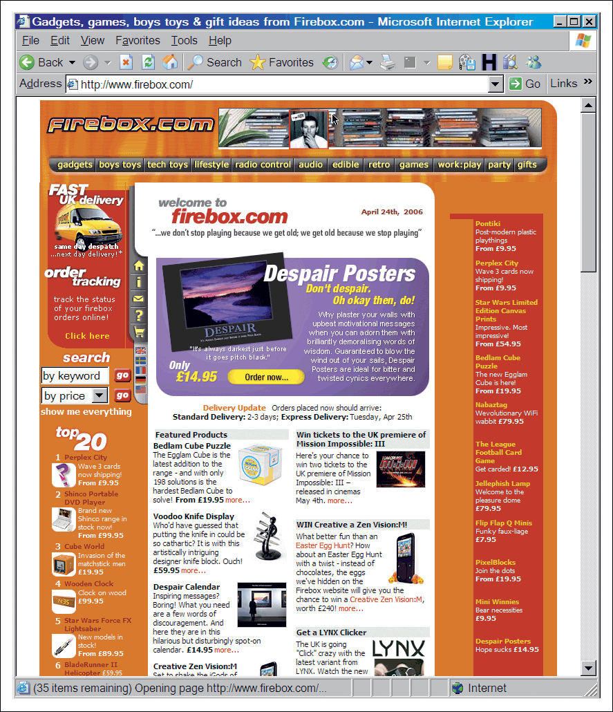
Figure 2.13 www.firebox.com

